Slide 1
Welcome slide
BENGALURU 2025

Slide 2
Application Modernization: Practical Patterns for Transformation using AI - Amazon Qn Developer
Ayyanar Jeyakrishnan
AWS Machine Learning Hero
Executive Director - Wells Fargo

Slide 3
Agenda
Developer Dilemma - In Current AI Era
Amazon Q Developer - Quick Overview
Greenfield vs Brownfield - Best Practices and Lesson Learnt.
Way to Vibe Code Effectively in #AISDLC

Slide 4


The Developer's Dilemma – Greenfield vs Brownfield
Sculpting the Future or Repairing the Past?” -
Refactoring Needs
Cloud-Native Design
Reverse Engineering
Automation and Speed
Legacy Tech Challenges
Modern Stack Focus
Brownfield System
Greenfield Project
Balancing Innovation and Legacy in Software Development
Notes:
On one side, we have Greenfield projects — the dream scenario for any developer or architect. You're starting fresh.
You define your architecture cleanly — microservices, event-driven patterns, serverless-first designs.
You choose the latest tech stacks — Spring Boot 3, Next.js, Rust, or whatever suits the mission best.
Your codebase can be test-driven from Day One.
You design your CI/CD pipelines upfront, automate security gates, and enforce best practices from the beginning.
It’s like being handed a blank block of marble. Creative freedom. No technical debt. No ‘dark corners’ left by developers who moved on.
But there’s a catch even here — In Greenfield, while you have the freedom to innovate, you also carry the responsibility to design wisely. Every architectural misstep early on can snowball. Every missing test today can become tomorrow’s legacy debt. So even in Greenfield, discipline matters.
Now flip the coin — Most of us, in reality, are handed Brownfield systems.
Existing applications built years — sometimes decades — ago.
Applications tied to old versions of Java, .NET, PHP, or even mainframes.
Business logic deeply embedded into massive, undocumented codebases.
SOAP APIs, monolithic databases, hardcoded workflows, forgotten CRON jobs running in some server room no one has access to.
Worse still — the developers who originally built these systems have long moved on. The documentation? Maybe there’s a 10-page Word doc from 2013 — if you're lucky. The tests? Often missing, outdated, or insufficient to guarantee safe changes.
Here’s the truly challenging part — Both Greenfield and Brownfield are under the same pressure:
Deliver faster.
Innovate constantly.
Reduce defects.
Meet business demands.
Maintain compliance and security.
But the starting lines are dramatically different.
In Greenfield, you’re racing on a freshly paved highway.
In Brownfield, you’re maneuvering through a dense, foggy forest full of unexpected turns and fallen trees.
And in today’s SDLC realities, developers face common pain points across both paths:
Context switching: From coding to debugging to deployment troubleshooting — within the same sprint.
Toolchain complexity: Dozens of tools to learn, integrate, and manage — from IDEs to deployment pipelines.
Manual drudgery: Writing boilerplate code, setting up repetitive infrastructure, refactoring low-value legacy code.
Knowledge loss: Institutional knowledge disappearing as teams evolve or vendors change.
Unclear ownership: Especially in Brownfield, figuring out “Who owns this module?” can be a project in itself.
Fear of change: "Will touching this break something we didn’t anticipate?" — the silent fear that slows down releases.

Slide 5

Common Challenges on Both the Path Currently
Still more Effort to Sculpt -
Context Switching
Manual Drudgery
Bug to Deploy
Boilerplate Code
Code to Bug
Manual Typing
Overwhelmed Developer at Desk
CI/CD
Institutional Knowledge
IDE
Disappearing Memory
Toolchain Complexity
Knowledge Loss
Notes:
"As we saw earlier, whether you are starting fresh with a Greenfield project or modernizing a Brownfield system — the developer’s struggle remains real."
At the heart of both journeys, developers face a common set of pain points that slow us down and drain our energy.
First, there’s Context Switching — constantly bouncing between coding, debugging, deploying, and then back again. Every shift fragments focus and increases cognitive load.
Then, there’s Manual Drudgery — Developers still spend significant time writing boilerplate code, setting up repetitive infrastructure, or manually typing updates that could be automated.
Toolchain Complexity adds another layer — Today, developers juggle 10–15 tools daily — from their IDE, CI/CD pipelines, cloud platforms, to monitoring systems. Each tool adds learning curves and integration challenges.
And then, Knowledge Loss creeps in — Critical institutional knowledge disappears when teams change or projects evolve, making it harder to maintain or safely modernize systems.
Finally, there's Fear of Change — Especially in Brownfield systems, developers hesitate: "If I touch this, will it break something that no one even remembers anymore?" And this fear often delays innovation.
All these challenges converge into what I call the Overwhelmed Developer at Desk — still sculpting, still chiseling, but with far more effort than necessary.
"Manual effort is hard — whether you’re building something new or fixing something old."

Slide 6

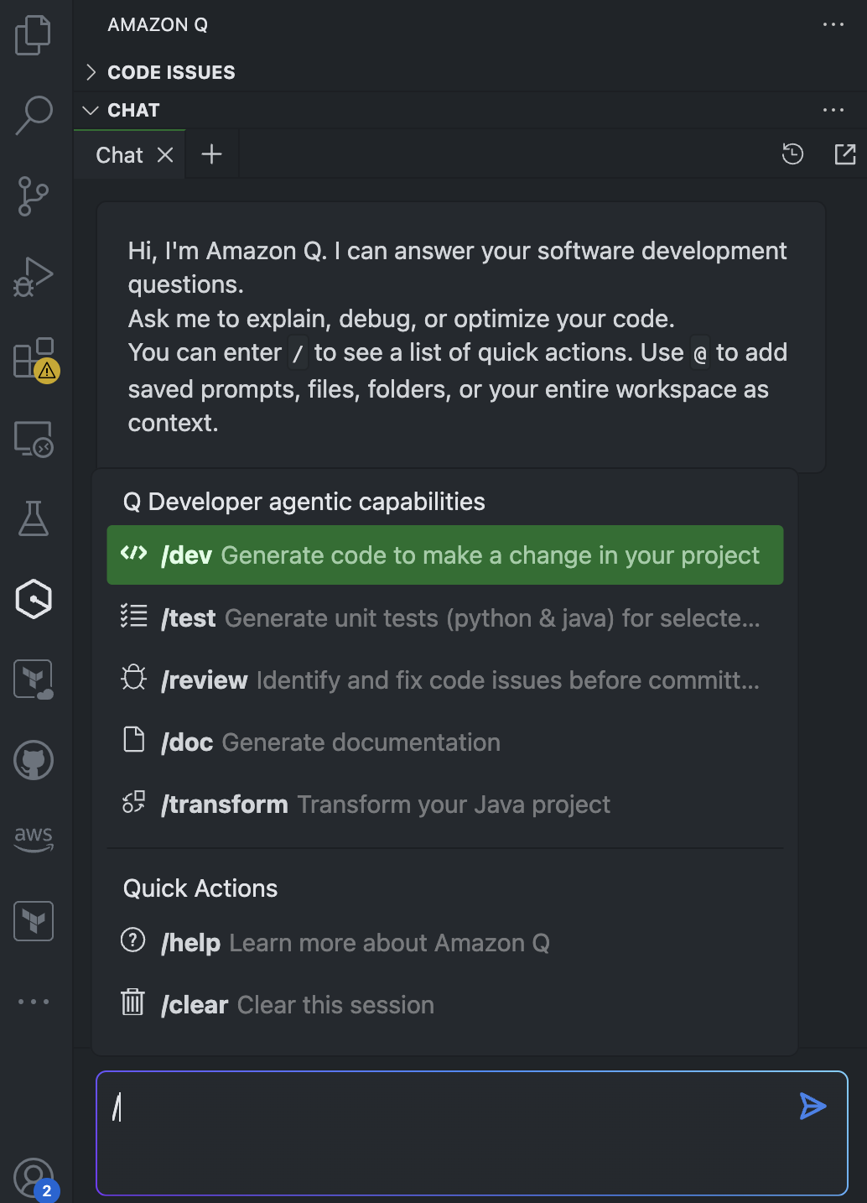
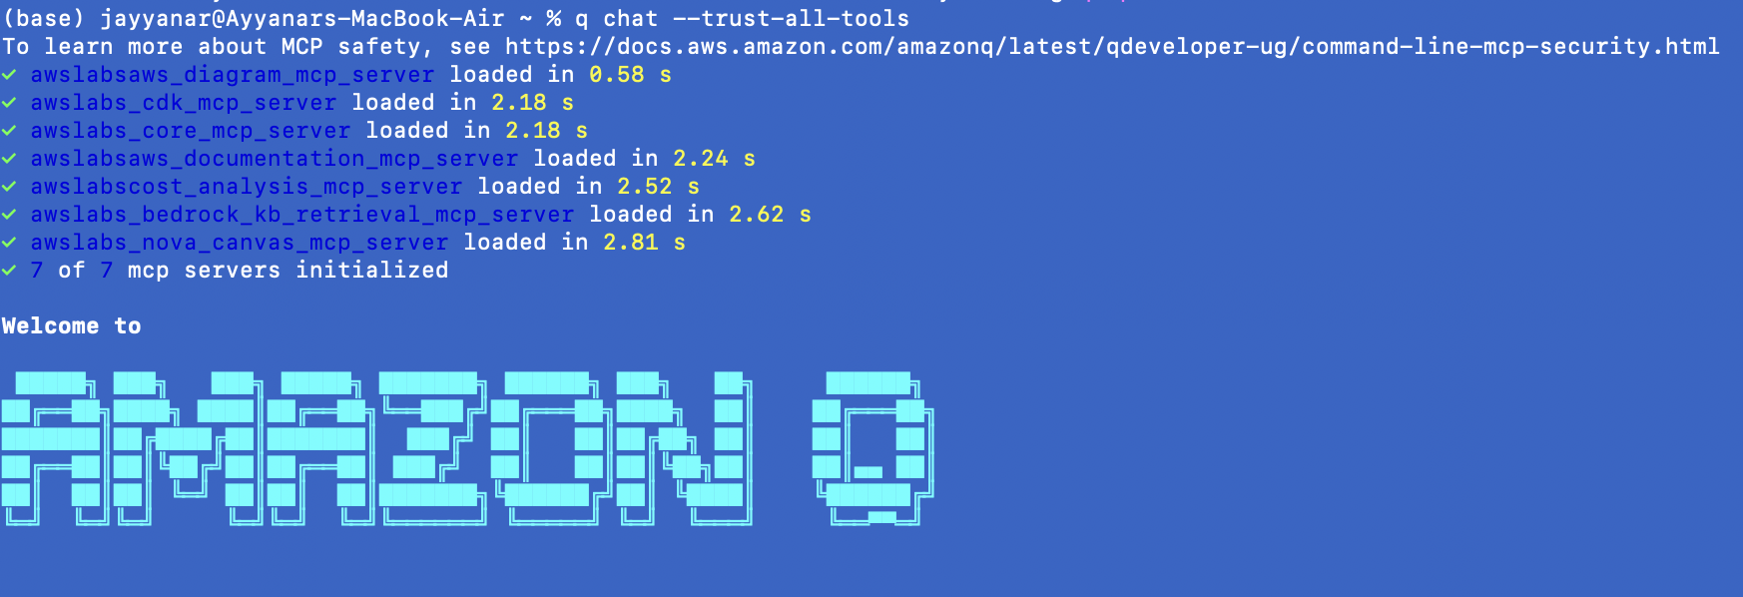
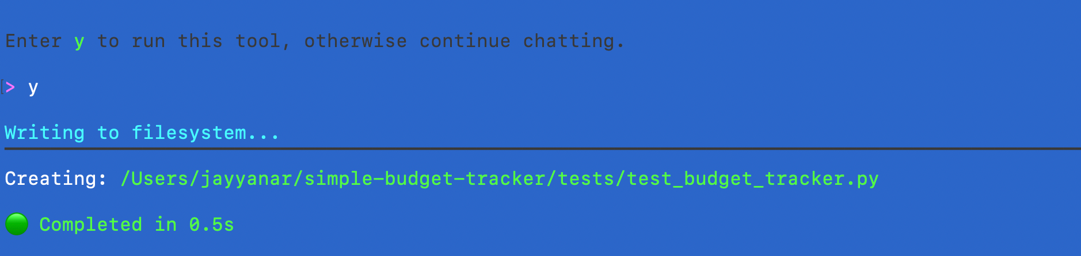
Amazon Q Developer Quick Overview
I am your buddy to make you excel -
At Your Favourite IDE
CLI
Notes:
On the left, you see it integrated directly into your favorite IDE — whether it’s VS Code or JetBrains. You can generate code, write tests, refactor Java projects, fix issues, or generate documentation — all conversationally.
You simply type a request like: “Generate unit tests for this class” or “Fix this bug” — and Q understands the intent, context, and writes production-ready code.
On the right, you see Amazon Q in CLI mode — This is incredibly useful for developers who prefer the terminal. Here I’m using a single command to create a test file for a budget tracker app — and Q does it in half a second. Clean, fast, no YAML wrangling, no guesswork.
Whether you’re in your IDE or terminal, Q meets you where you are — like a buddy who actually codes with you.

Slide 7
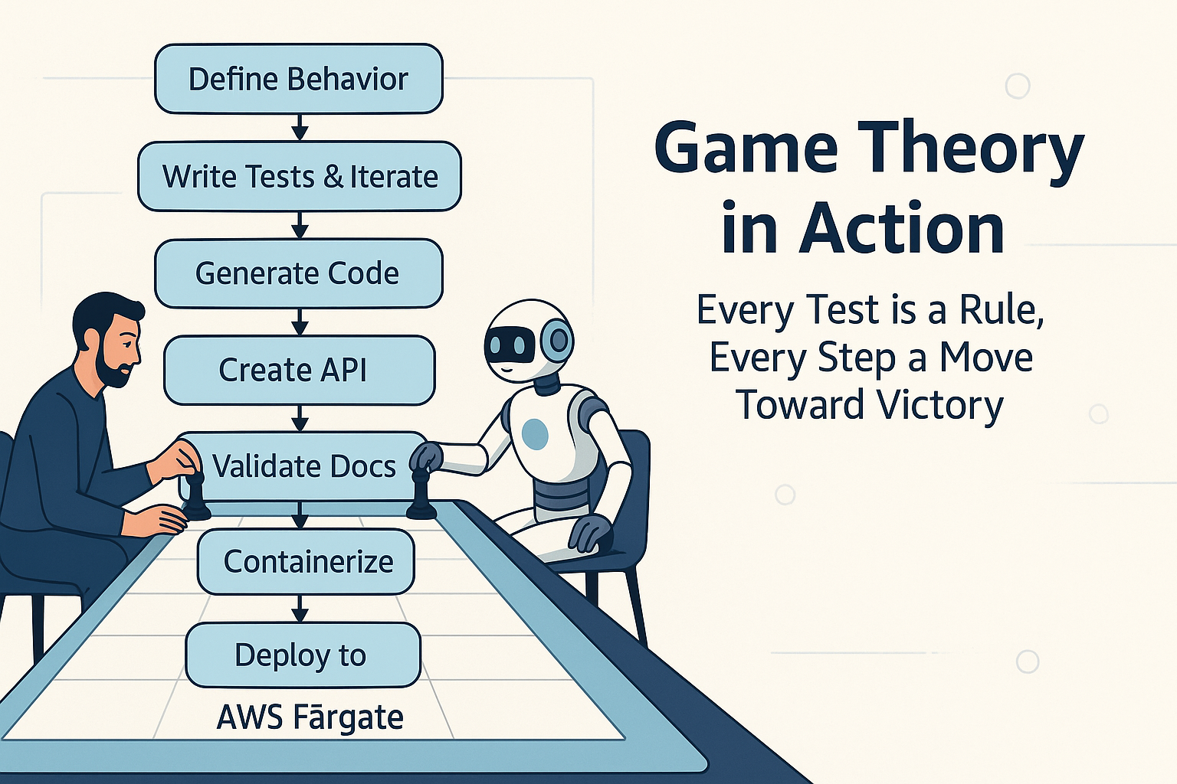
Greenfield Advantage – Coding as Game Theory
- Set the Rules, Let the AI Play -
Notes:
“Now let’s talk about one of the most powerful shifts happening in software development today — the idea of treating coding as a game of strategy.”
In a Greenfield application, you're starting with a blank slate. No legacy code. No design debt. And that gives you a unique opportunity — not just to code faster — but to code smarter.
Imagine you’re setting up a game. You define the objective first: What should the application do? That’s your behavior spec.
Next, you define the rules — and those are your tests. In a Test-Driven Development (TDD) flow, these rules come before a single line of business logic is written. Each test describes what a successful move looks like — "This function must return this output", "This API must validate this input", and so on.
Now enter Amazon Q Developer — your AI teammate. You give it the rules, and it starts playing the game.
It generates the code not randomly, but with the explicit goal of making those tests pass.
It creates APIs based on defined behavior.
It validates docs and even refines code as more rules emerge.
It containerizes and deploys to AWS Fargate — all in a step-by-step strategy loop.
The key here is that Amazon Q doesn’t just generate code; it strategizes — it treats the test suite as a boundary of play, and every piece of output is a calculated move toward your definition of success.
This is game theory in action: You, as the developer, define the victory conditions. Amazon Q, the AI assistant, works turn-by-turn — learning from failure, responding to errors, and improving code until it meets the goal.
And here’s the beauty — this approach isn’t about replacing developers. It’s about elevating us. We move from constantly debugging and writing boilerplate to designing systems, enforcing quality through tests, and guiding architecture from the top down.
So if you’re building Greenfield systems today — Start with behavior. Turn your expectations into tests. And then let the AI play to win, on your terms.
“Set the rules. Let the AI play. And together, you’ll ship better software — faster, cleaner, and confidently.”

Slide 8
Test-Driven AI – Modern Code, Minimal Touch
- From Idea to Production with Precision Iteration of Prompt -
Developer and AI Collaboration
AI Interpretation
Iterative Process
The developer and AI begin working together right from BDD
The AI interprets the prompt to understand the task
The process is repeated to refine the application
Prompt Creation
Test-Driven Development
Code Generated
A clear prompt is formulated to guide the process
Validated against the TDD
Tests are written before coding to ensure quality
Notes:
In an AI-driven software development lifecycle — or what I call the AIDLC — the way we guide the AI becomes just as important as what we build."
This slide outlines a high-trust workflow where a developer collaborates with an AI assistant — and every step is driven by clarity and validation.
Let’s walk through this.
We begin with Developer and AI Collaboration. This partnership starts even before a single line of code is written. We align on Behavior-Driven Development (BDD) principles — clearly stating what the application is supposed to do.
Then we move into Prompt Creation. Now, here’s the catch: AI can generate impressive code, but only as good as the prompt we give it. If your prompt is vague, generic, or missing constraints — the AI will fill in gaps with guesses. But if your prompt is structured, precise, and includes behavioral expectations — that’s where the magic happens.
This brings us to the next step: AI Interpretation. The AI consumes the prompt, understands the task, and prepares to respond — But unless you’ve defined tests ahead of time, the AI doesn’t actually know if the output is correct or useful.
That’s why Test-Driven Development is the key to all of this. TDD gives us the truth mechanism — a way to ensure the AI isn’t just generating code, but generating correct code. When you define tests first — even simple unit tests — you’re effectively setting the rules of the game. Now the AI’s job isn’t just “write code,” it’s “write code that passes the tests I defined.”
This unlocks the next big advantage: Iteration.
In the real world, your first prompt won’t always produce perfect results. But because you have tests in place and a clear behavior defined, you can now refine your prompt with surgical precision. Maybe the logic was off — you tweak a test. Maybe the AI misunderstood — you adjust the prompt. And this loop continues until the test suite passes and the code matches your intent.

Slide 9
Scaling the Legacy Refactor with AI
Transformation of SOAP to REST with Amazon Q
Legacy SOAP Service
Design REST Endpoint
Modern RESTful Service
Developer examines WSDL file
Amazon Q designs the REST endpoint
Developer reviews clean REST controller code
/doc
/doc
/dev
/dev
/dev
Analyze WSDL
Refactor Service Logic
Amazon Q analyzes the WSDL file
Amazon Q refactors the service logic
Notes:
We’ve all worked with systems that still rely on WSDL-based SOAP APIs, often written in older Java versions like Java 8. They tend to be verbose, tightly coupled, and difficult to scale — especially when you're aiming for modern architectures like microservices or serverless.
This slide shows how we tackled this very problem — using Amazon Q Developer as a powerful co-pilot in our modernization journey.
Let’s walk through the transformation from left to right:
1️⃣ Legacy SOAP Service – Analyze WSDL
It begins with a developer examining a WSDL file — trying to understand what this SOAP service actually does. This can be time-consuming on its own, but here’s where Amazon Q steps in: Q analyzes the WSDL, extracts the service definition, and understands the operations exposed — effectively giving us a starting point to work from.
2️⃣ Design REST Endpoint
Once the SOAP structure is understood, we prompt Amazon Q to design equivalent RESTful endpoints. Q automatically generates the endpoint signatures based on the WSDL structure, mapping inputs and outputs into JSON and aligning with REST conventions. This saves hours of boilerplate conversion and ensures the transformation aligns with REST best practices.
3️⃣ Refactor Service Logic
Now comes the real value — we refactor the actual service logic. We extract the business logic from the old SOAP controllers and Amazon Q rewrites it into clean REST controller code, while preserving functional behavior. Throughout this step, we rely on prompt-driven instructions and unit tests as a compass. If tests fail, we fine-tune the prompt or add guardrails — it’s an iterative, AI-assisted process that ensures quality.
4️⃣ Modern RESTful Service – Final Output
At this stage, what we have is a clean, validated REST controller that matches the intended behavior of the original SOAP service — but now it’s lightweight, maintainable, and cloud-deployable.
The developer simply reviews the final output, ensuring everything passes the test suite and business behavior remains intact.
“This is the power of using Amazon Q in brownfield modernization — it doesn’t try to replace the developer, but it massively accelerates the transformation, reduces manual effort, and keeps quality at the forefront.”
From WSDL to working REST controller — what used to take days, now takes hours — and we get consistent, test-aligned refactoring at scale.

Slide 10
Scaling the Legacy Refactor with AI
Complex Java Application Modernization
Legacy Monolith Wall
Step 1: Code Inventory
Java 8 Monolith with SOAP and WSDL with 1000+ Classes
Parse classes, methods, relationships
Step 2: Behavior Definition (BDD)
Step 3: Test Creation
Lock current behavior with Unit tests
Write expected outcomes in plain English
Step 4: Refactor with Amazon Q
Step 5: Iterative Validation
Convert to Java 17 + REST, class by class
Refine prompt or fix test on failure
Step 6: Modular output
Validate the RESTAPI - Component by Component
Notes:
“Let’s now look at how we approach something that often feels overwhelming — modernizing a large Java monolith with 1,000+ classes, SOAP services, and outdated architecture.”
We’ve all seen systems like this — they work, but they’re tightly coupled, hard to change, and usually lack proper test coverage.
This slide shows our structured approach — a step-by-step breakdown that makes this modernization not just possible, but scalable. And at every step, Amazon Q becomes a multiplier — helping us move faster, safer, and with precision.
🔹 Step 1: Code Inventory
We begin by parsing the entire legacy codebase. Using scripts, we generate an inventory of:
Classes, methods, and dependencies
WSDL mappings and SOAP interfaces
This step is like X-raying the monolith — giving us visibility into what we’re dealing with.
🔹 Step 2: Define Behavior (BDD)
Next, we write plain-English behavior definitions — like:
“Given a valid customer ID, the service should return a full customer profile.”
These become our acceptance criteria and also guide Amazon Q’s refactor logic later.
🔹 Step 3: Test Creation
Here’s where we lock in the current behavior. Even if the system has zero unit tests, we create tests for each key function.
And here, Amazon Q helps generate tests quickly — we simply provide the function and behavior, and Q scaffolds JUnit or integration tests. These tests are crucial — they give us the safety net to modernize without fear.
🔹 Step 4: Refactor with Amazon Q
Now the fun part.
We go class-by-class, using Amazon Q with structured prompts, like:
“Convert this SOAP-based service to a Java 17 REST controller using Spring Boot. Retain behavior. Must pass existing tests.”
Amazon Q ingests the old logic, applies modern best practices, and gives back test-aligned RESTful code — in seconds.
🔹 Step 5: Iterative Validation
This step is essential. If a test fails, we either refine the prompt or debug the logic.
We treat this like a game of test-driven collaboration:
We define the rules (via tests)
Q plays to win (via generated code)
If it misses, we tune the prompt Iteration is how precision is achieved.
🔹 Step 6: Modular Output
The end result isn’t one massive rewrite — It’s a modular, validated, modern service suite:
REST APIs
Java 17
CI/CD compatible
Test-covered
Cloud-ready
And all built incrementally — class by class, prompt by prompt, test by test.
💡 Final Message
“You don’t modernize a legacy system by brute force. You do it with clarity, structure, and AI assistance — one intelligent, test-driven refactor at a time.” Amazon Q isn’t just code generation — it’s an accelerator for disciplined engineering.

Slide 11

Demo – AI in Action
- Watch the Chisel Turn Robotic -

Slide 12
Lessons Learnt on Amazon Q - Greenfield
5) Demo Application: Budget Tracker
1) Break Down Complex Problems
Architecture Compatibility
Puzzle Pieces
Infrastructure Handling
Developer Planning
Container Commands
Greenfield Development with Amazon Q
2) Iterate and Build Context
4) Always Iterate
Chat Bubbles
Checklist
Feedback Loop
Code Revisions
3) No-Touch Coding
Let Q do the Coding
Human Reviewing
Notes:
When building a Greenfield application with Amazon Q, we learned some important lessons that are worth sharing.
First, we realized it’s crucial to break down complex problems. Instead of asking Q to build an entire system at once, we divided it into smaller, logical chunks — requirements, tests, core APIs, frontend, and deployment — handling one at a time.
Second, it’s not enough to prompt once. We had to iterate and build context with each prompt — adding feedback like “this API works, now add validation” or “fix the 403 error” to guide the next output.
And third — even with AI, never assume the first output is final. AI gets you 80% there fast, but real success comes by iterating over results, refining tests, and improving prompts continuously.
One of the best parts was experiencing No-Touch Coding — where Amazon Q handled not just snippets, but full working solutions — but it’s important to note that while the AI can code, your oversight remains critical for ensuring quality.
For the Demo Application — the Budget Tracker project — we faced a few practical lessons too:
Architecture compatibility mattered: since we were deploying to AWS Fargate (x86), we had to explicitly set platform flags when building containers from an Apple M1 laptop.
We made our infrastructure flexible by conditionally handling resource creation to avoid errors.
And finally, for early stages, we kept deployment simple — running directly with Python servers instead of jumping into complex Gunicorn setups — ensuring stability first before scaling.
Greenfield development isn’t about rushing — it's about using AI to accelerate with precision, iteration, and engineering discipline.

Slide 13
Lessons Learnt on Amazon Q - Brownfield
1) Codebase Discovery and Dependency Mapping
2) Define Behavior Before Code
Map Classes
Write Comprehensive Behavior Document
Map Services
Brownfield Modernization Journey
5) Iterate, Validate, and Adjust Prompts
3) Lock the Logic with Tests
Feedback Loop
Build TDD for New Java Version
Refine Prompts
4) Controlled Modernization
Brick-by-Brick Reconstruction (One Class at a time)
Modular Architecture
Notes:
"When it comes to Brownfield modernization, working with legacy systems brings unique challenges compared to Greenfield development."
The first big lesson was to Perform Codebase Discovery and Dependency Mapping. Before touching a single line of legacy code, we used agents and static analysis to map out classes, methods, and service relationships. This early investment gave us clarity on how modules were interdependent and where modernization could start safely.
Next, we adopted a Behavior First, Code Second mindset. Using tools like Amazon Q’s /doc agent, we extracted intended behaviors before worrying about code refactoring. Having behavior defined upfront in a human-readable format gave the AI clear targets to hit during transformation.
Third, we made sure to Lock the Logic with Tests. In Brownfield systems, tests are often missing. So before making changes, we built unit and integration tests to create a safety net — ensuring modernization didn’t break critical behavior.
Importantly, we Iterated, Validated, and Adjusted Prompts. Legacy code is messy — no single prompt fixes it all. We treated Amazon Q interactions like a conversation: prompt, test, adjust, re-prompt — until the tests passed and the behavior was preserved.
Finally, modernization was never a "big bang." We focused on Controlled Modernization – One Class at a Time. One small validated change after another, steadily evolving the monolith into a modular, testable system.
A few practical deployment lessons we also learned:
Respect Context Limits: Feed Q smaller, manageable slices of code, not the entire monolith at once.
SOAP to REST Requires Careful Mapping: Input/Output contracts had to be manually validated post-conversion.
Data Models Need Migration: XML-based schemas were carefully migrated to DTOs or POJOs in Java 17.

Slide 14

AI SDLC
Notes:
On the left, you see the traditional sculptor — chisel in hand, carefully shaping marble one strike at a time. That’s how software used to be built — entirely manual, highly dependent on individual craftsmanship, effort, and time.
But on the right, we see a modern shift: A new sculptor — not holding the chisel, but guiding a robotic arm powered by intelligence. She isn’t removed from the process — she's more strategic now. She sets the direction, inspects the details, and provides creative judgment — while the AI handles the execution.
That’s the AI-powered SDLC.
This is not about replacing developers. It’s about elevating them — freeing them from low-value manual toil so they can focus on what really matters:
Architecture
Design decisions
Behavior specification
Quality gates
And innovation
And the quote beneath the image captures it perfectly:
“The sculptor’s hand need not hold the chisel to shape the stone. The sculptor’s mind — the vision, the feedback, the critical eye — that is what turns marble into art.”
In today’s world, Amazon Q, and tools like it, are the robotic arms in our workshops. But it is your intent, your test cases, your prompts, and your architecture that shape the final product.
So let’s not fear the shift — let’s guide it. Let’s not just write code faster — let’s build smarter, more predictably, and more collaboratively — with AI as our co-creator.

Slide 15

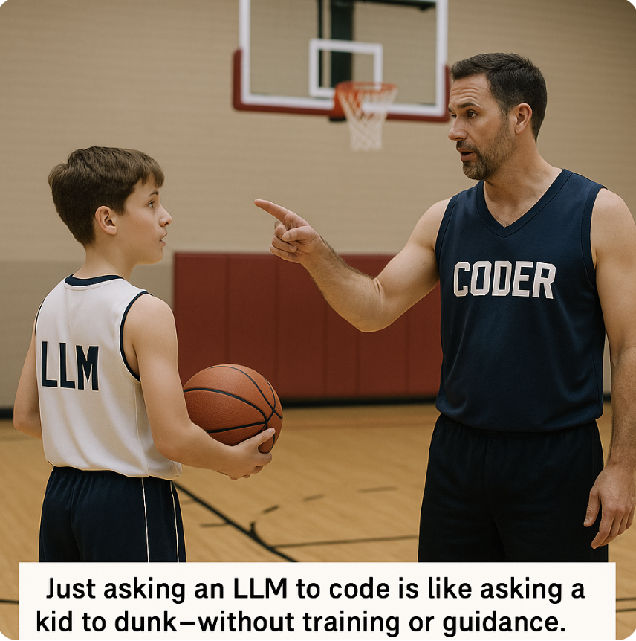

My understanding of #AISDLC effectively
Notes:
Image 1 (LLM & Coder):
"Just tossing an LLM into your codebase and expecting magic is like asking a kid to dunk. No training, no game plan, no foundation — just wishful thinking."
Image 2 (Vibecoder Shooting):
"With strong prompting and iterative refinement — you're setting up your shot. Each prompt is a pass, every test case is a play strategy."
Image 3 (Greenfield Execution):
"And when you're in a Greenfield project, with clean architecture and no blockers, the execution is crisp and confident.

Slide 16

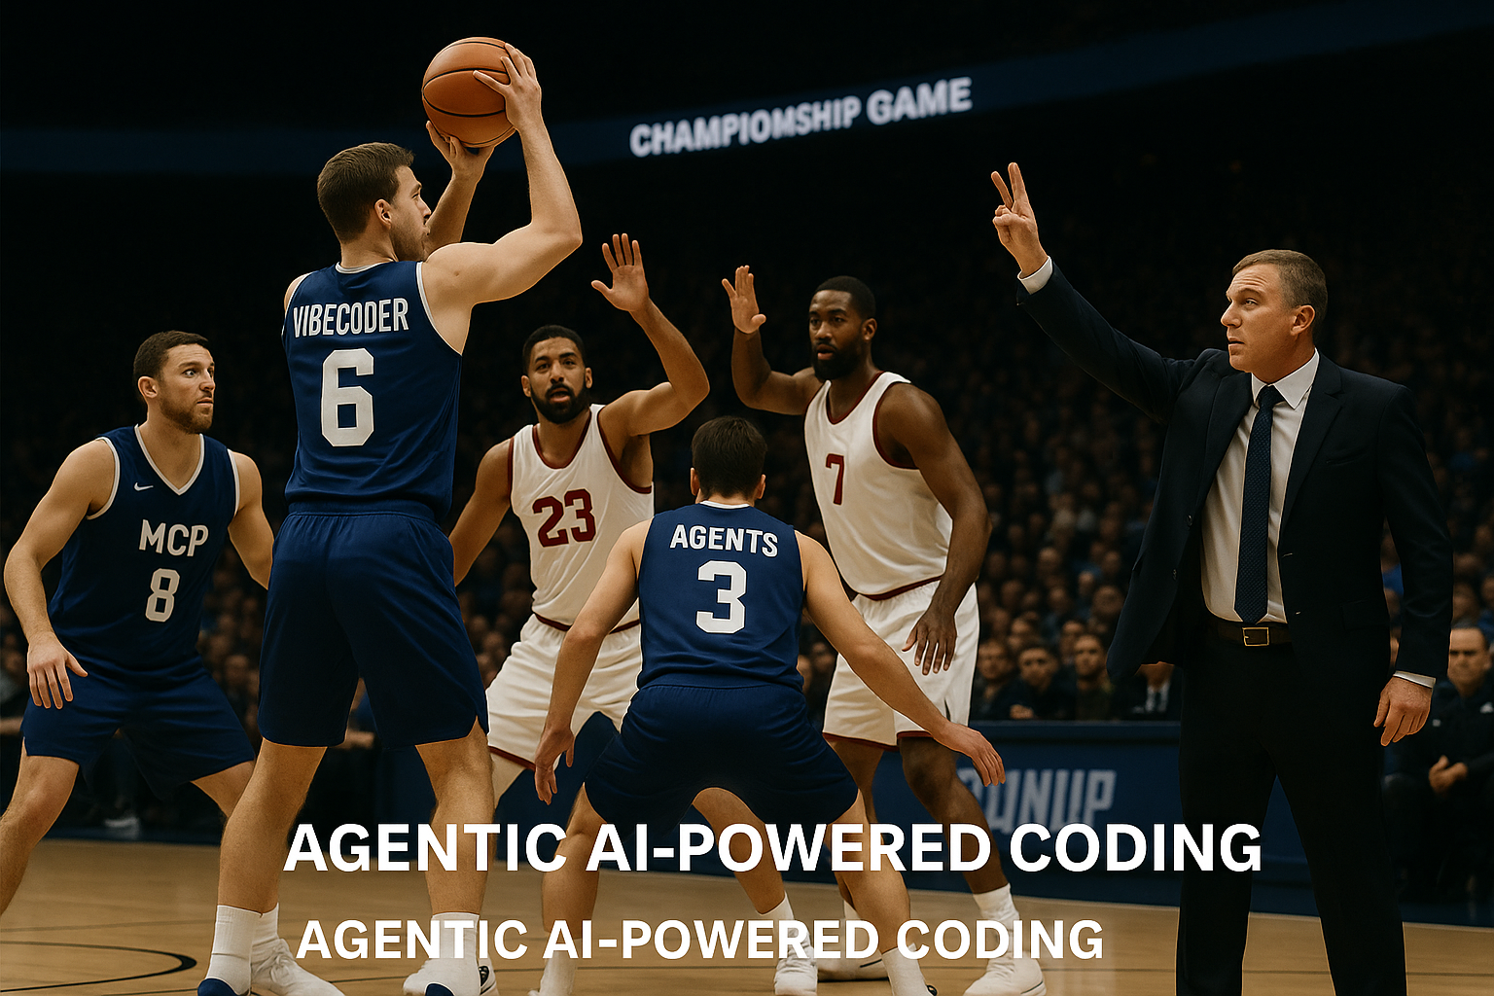
My understanding of #AISDLC effectively
Notes:
"This is the Brownfield world — high-stakes, crowded, defensive pressure. Our player — the 'Vibecoder' — is pushing solo toward the hoop. He’s skilled but heavily resisted by legacy blockers: outdated code, tight coupling, untested logic.
That’s how many of us build today — individual effort, legacy baggage, and high effort per win."
Right Side – Agentic AI-Powered Coding (Image 1, Slide 1):
"Now contrast this with Agentic AI-powered coding. Here, 'Vibecoder' is still on the court — but look at his support:
MCP (Model Context Protocol) setting up play context
Agent 3 shielding blockers
And a coach — maybe Amazon Q — guiding strategy from the sidelines.
This is how modern development should feel: coordinated, assisted, and structured.

Slide 17
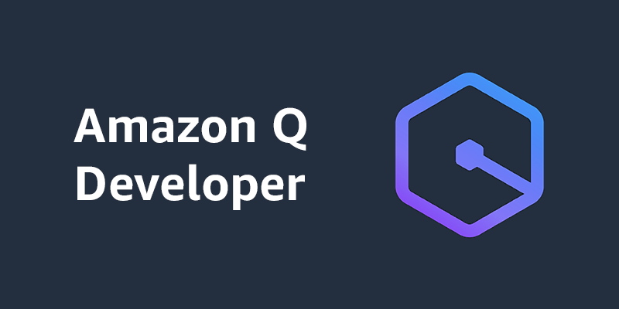
Vision & Velocity – The Road Ahead
- "In the age of AI, vision is the new velocity." -
Amazon Q isn’t just code generation
- it’s an Accelerator for future Builders and Innovators -
Notes:
AI-SDLC isn’t about replacing developers — it’s about leveling up the entire game.
With good prompting, solid context, and the right agentic setup, developers don’t just play — they win

Slide 18
Resources
Vibe Coding with MCP Server - https://www.youtube.com/live/qXGQQRMrcz0?si=xG4diIYFVdIXEt6a
MCP Server with AWS
https://www.youtube.com/live/15XhkcQdSrI?si=KdwUUuLTf47wP6p9
Current Demo - https://github.com/jayyanar/simple-budget-tracker
Notes:
On one side, we have Greenfield projects — the dream scenario for any developer or architect. You're starting fresh.
You define your architecture cleanly — microservices, event-driven patterns, serverless-first designs.
You choose the latest tech stacks — Spring Boot 3, Next.js, Rust, or whatever suits the mission best.
Your codebase can be test-driven from Day One.
You design your CI/CD pipelines upfront, automate security gates, and enforce best practices from the beginning.
It’s like being handed a blank block of marble. Creative freedom. No technical debt. No ‘dark corners’ left by developers who moved on.
But there’s a catch even here — In Greenfield, while you have the freedom to innovate, you also carry the responsibility to design wisely. Every architectural misstep early on can snowball. Every missing test today can become tomorrow’s legacy debt. So even in Greenfield, discipline matters.
Now flip the coin — Most of us, in reality, are handed Brownfield systems.
Existing applications built years — sometimes decades — ago.
Applications tied to old versions of Java, .NET, PHP, or even mainframes.
Business logic deeply embedded into massive, undocumented codebases.
SOAP APIs, monolithic databases, hardcoded workflows, forgotten CRON jobs running in some server room no one has access to.
Worse still — the developers who originally built these systems have long moved on. The documentation? Maybe there’s a 10-page Word doc from 2013 — if you're lucky. The tests? Often missing, outdated, or insufficient to guarantee safe changes.
Here’s the truly challenging part — Both Greenfield and Brownfield are under the same pressure:
Deliver faster.
Innovate constantly.
Reduce defects.
Meet business demands.
Maintain compliance and security.
But the starting lines are dramatically different.
In Greenfield, you’re racing on a freshly paved highway.
In Brownfield, you’re maneuvering through a dense, foggy forest full of unexpected turns and fallen trees.
And in today’s SDLC realities, developers face common pain points across both paths:
Context switching: From coding to debugging to deployment troubleshooting — within the same sprint.
Toolchain complexity: Dozens of tools to learn, integrate, and manage — from IDEs to deployment pipelines.
Manual drudgery: Writing boilerplate code, setting up repetitive infrastructure, refactoring low-value legacy code.
Knowledge loss: Institutional knowledge disappearing as teams evolve or vendors change.
Unclear ownership: Especially in Brownfield, figuring out “Who owns this module?” can be a project in itself.
Fear of change: "Will touching this break something we didn’t anticipate?" — the silent fear that slows down releases.

Slide 19
Notes:
Come join the millions learning with AWS Training and Certification and accelerating their impact.
In the classroom or online at your own pace, learn what you want, when you want, and how you need it.
Visit Skill Builder, our online center and explore over 600 free digital courses, hands-on labs, and role-based games.
For team and individuals looking to dive deeper, Skill Builder Subscriptions provide access to premium content and administrative benefits.
And when you’re ready, discover industry-recognized AWS Certifications that showcase your expertise and grow your career potential.
Technology makes innovation possible, but it’s people who will build a better tomorrow. Your time is now.

Slide 20


Thank you
Ayyanar Jeyakrishnan
@meet_ayyanar
linkedin.com/in/jayyanar/

